Slide 1

What is Ethereum Virtual Machine?
1

Slide 2
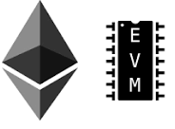
Ethereum Virtual Machine
It provides a runtime environment for decentralized applications on Ethereum platform like smart
contracts.
Instead of building an entirely original Blockchain for each new application, EVM enables the development of potentially thousands of different applications all on one platform.
Since the Ethereum Virtual Machine is completely isolated from the rest of the main network, it is a
perfect testing environment.
Every Ethereum node in the network runs an EVM implementation and executes the same instructions.
It has been implemented in Python, Ruby, C++, and a few other programming languages.

Slide 3
THANK YOU!

